Slide 1

Hosted Buyer
Meetings Platform
User Guide

Slide 2

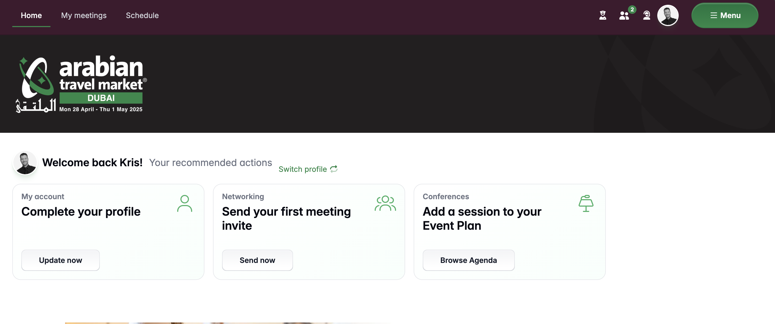
ATM Meet
ATM Meet is the online meeting platform you will be using to pre-schedule all your meetings
You will receive an email with your unique login details
At the point of signing in for the first time, please complete your profile
Please complete your buyer & company profiles with as much relevant information as possible
Once you have signed into the platform, your profile will be live and visible to the Exhibitors. This is why it is important to complete your profile as a top priority before you do anything else
Once your profile and company profile has been completed, head to the ‘My event plan’ tab to block out your lunch breaks

Slide 3
Platform Login & Setup
When you first login, the first thing is to complete your buyer and company profile in full and with as much information as you can
Complete profiles receive much better visibility in the platform and is a requirement of the Hosted Buyer programme
Follow all the task card prompts until each task has been completed

Slide 4
Overview

Slide 5
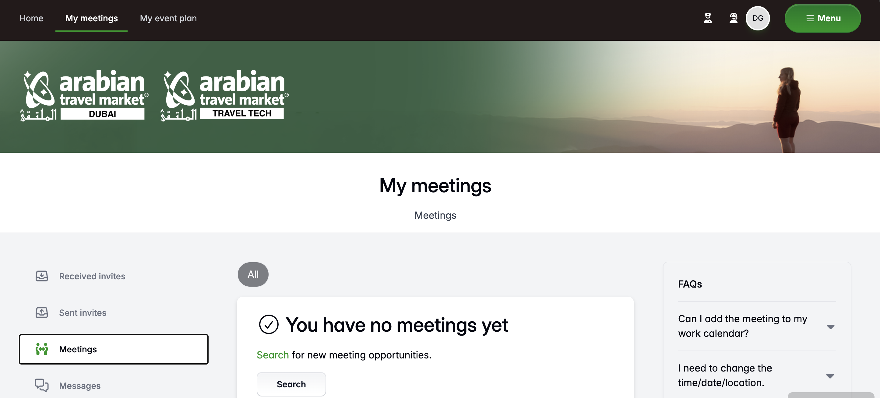
The Home Page
From your home page you will be able to:
  Access your Inbox to send and receive meeting requests
  Access your ATM Diary and view your confirmed meetings
  Schedule content sessions
  Search Exhibitors via the Find People tab
  View an alphabetical list of Exhibitors via the Exhibitor Directory
  Search Exhibitors by Products
  Update your Hosted Buyer & Company Profile

Slide 6
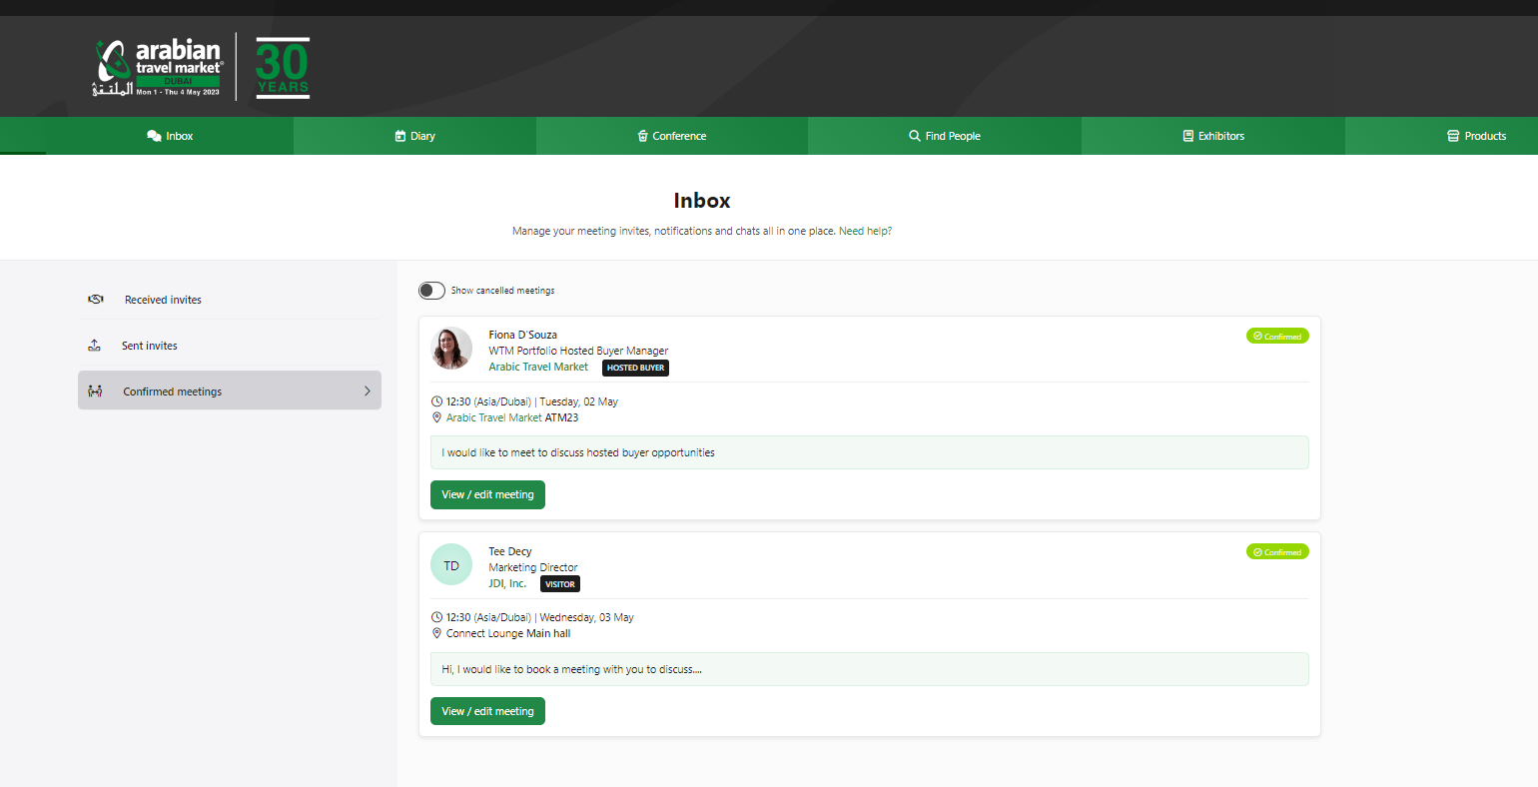
Your Meetings Inbox
It is really important to check your ‘My meetings’ folder regularly which is accessible via the tab on your home page
It is is where you will see:
    Meeting invites sent
    Meeting invites received
    Meetings confirmed
    Messages from your meeting partners

Slide 7
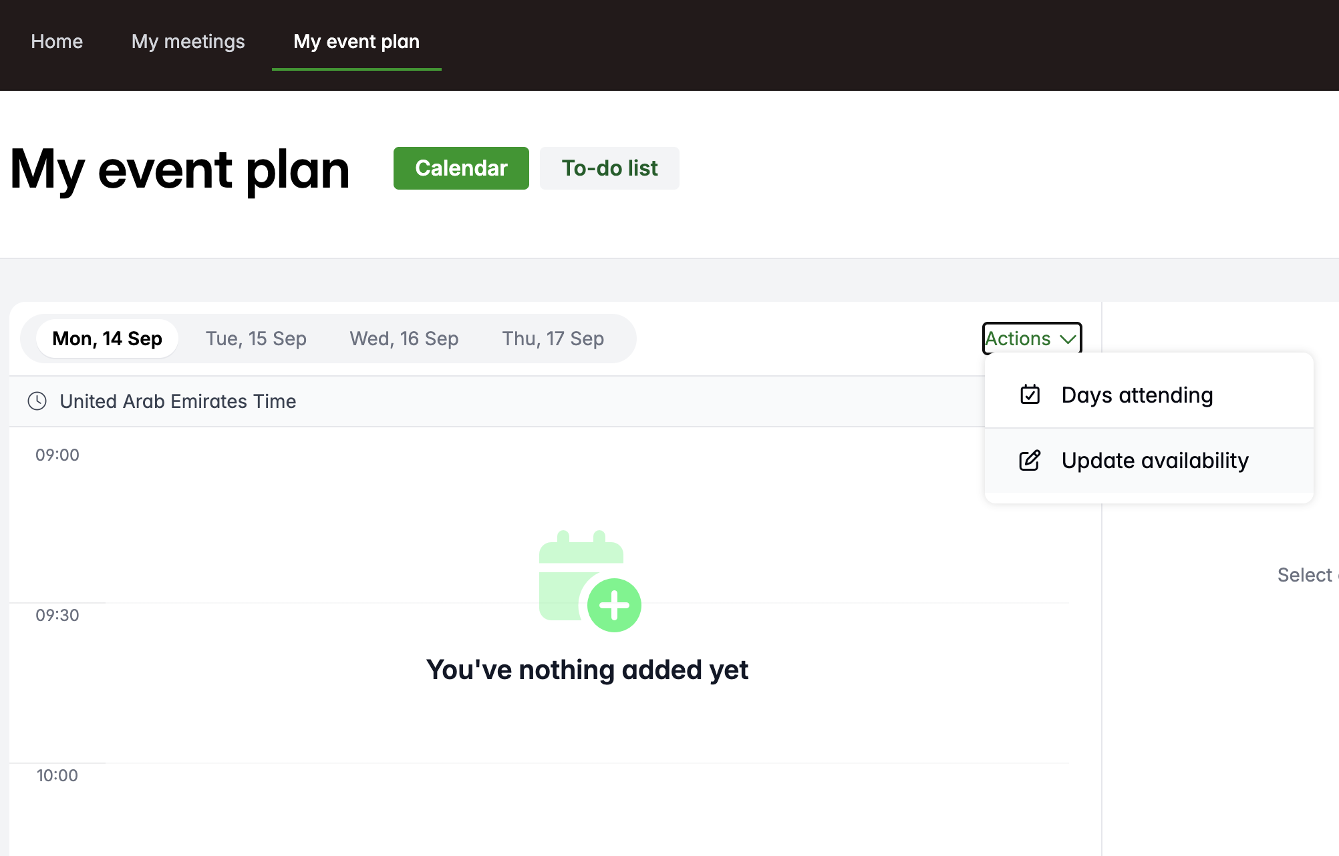
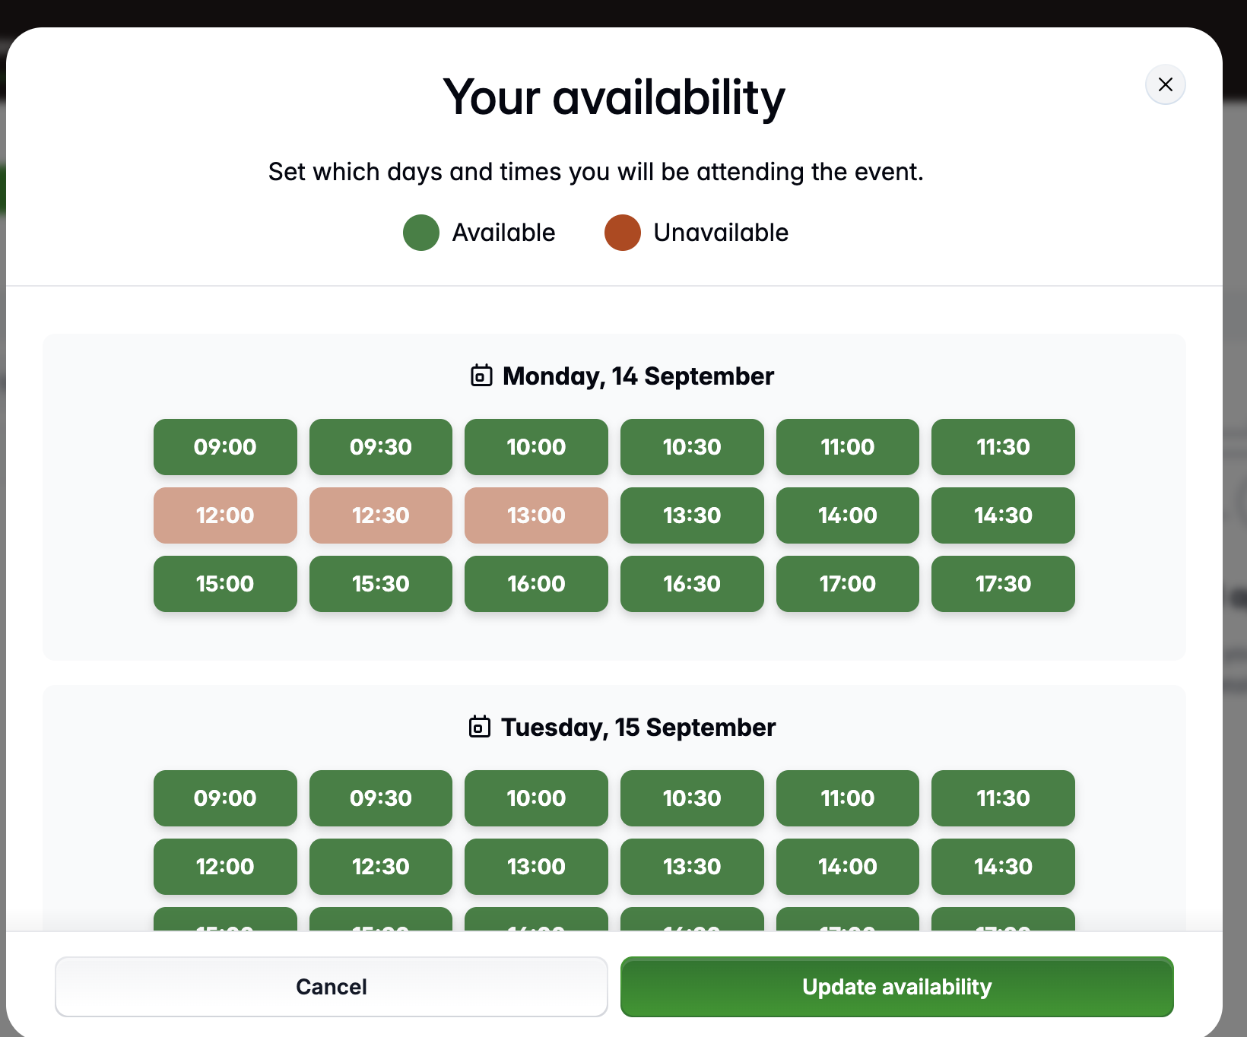
Your Diary
The ‘My event plan’ tab on your dashboard shows your appointment diary to include your confirmed meetings and conference sessions
Meetings and conference sessions will be added automatically once confirmed
Ensure you block out any times you will not be available before you request or accept any meetings by clicking on the ‘Update Availability’ button. Don’t forget to schedule in a lunch break!
Once you have confirmed your meetings you can download your full schedule before you leave for the show

Slide 8
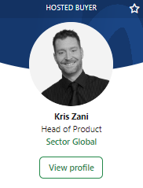
Hosted Buyer Directory
The Hosted Buyer Directory will:
  Be displayed on the Exhibitor dashboard only
  Include a direct link to your Hosted Buyer Profile
  Allow leading suppliers to connect with you easier and quicker than ever before
  Enhance your exposure at the show
  Increase business meeting opportunities
  Showcase your products and geographical areas of interest to key suppliers
  Not completing your profile in full will affect your appearance in the Hosted Buyer Directory

Slide 9
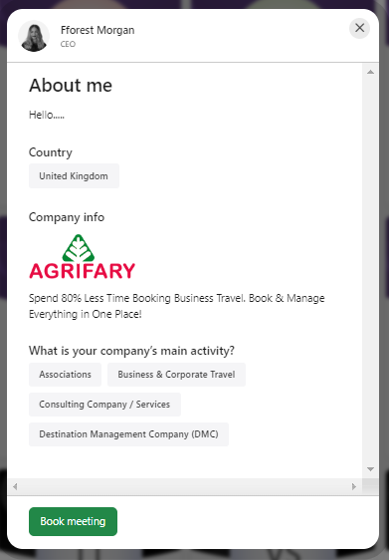
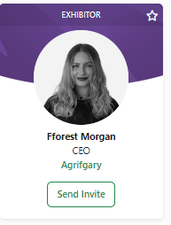
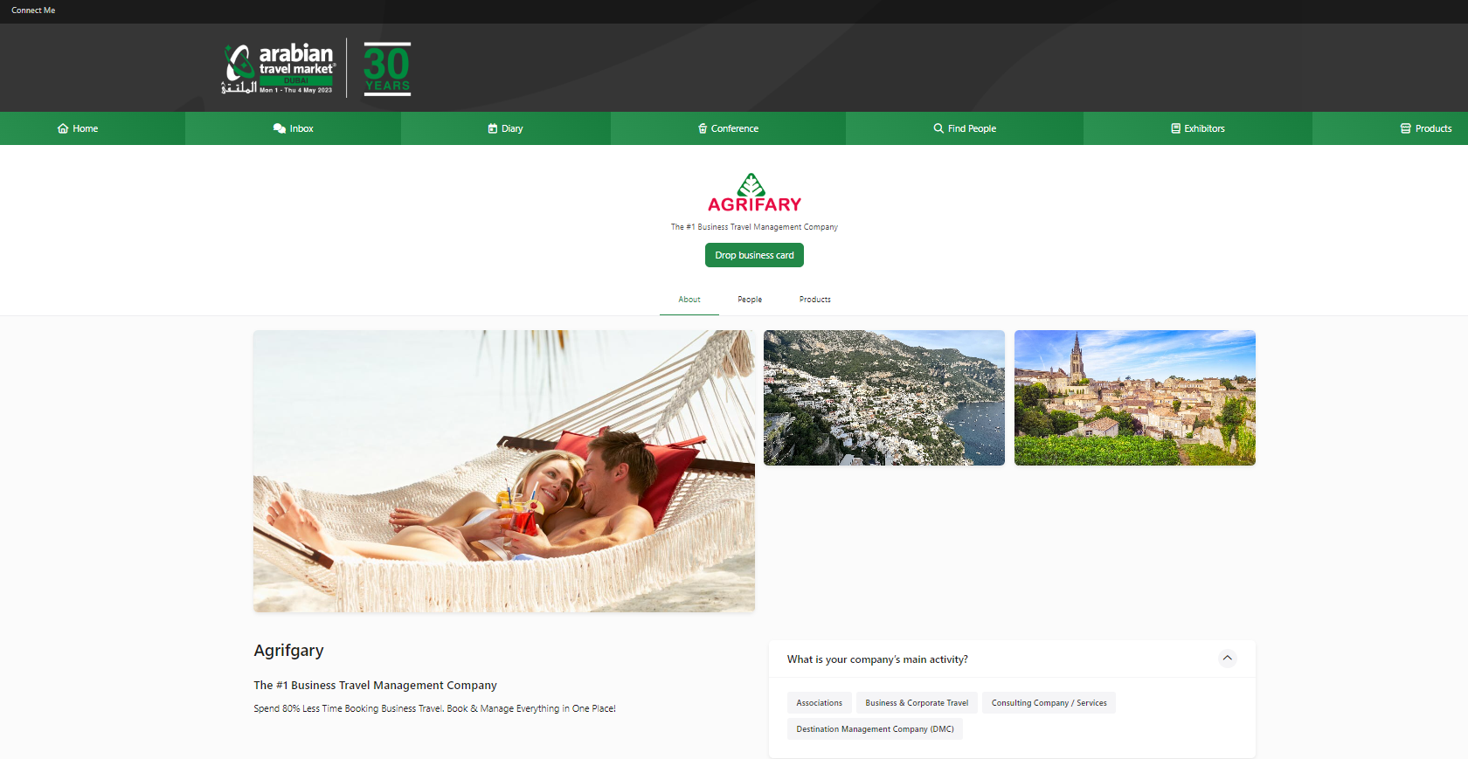
Exhibitor Profile Cards
Click on the photo of the Exhibitor profile card to learn more about the supplier you are interested in and their products and services
Click on the company name to see more company information and other exhibiting delegates
You will only be able to make meetings if you and the supplier have mutually available times in your schedules
Click on the profile picture to find out more about the Exhibitor delegate
Click on the company name to find out more about the company & find other company delegates

Slide 10
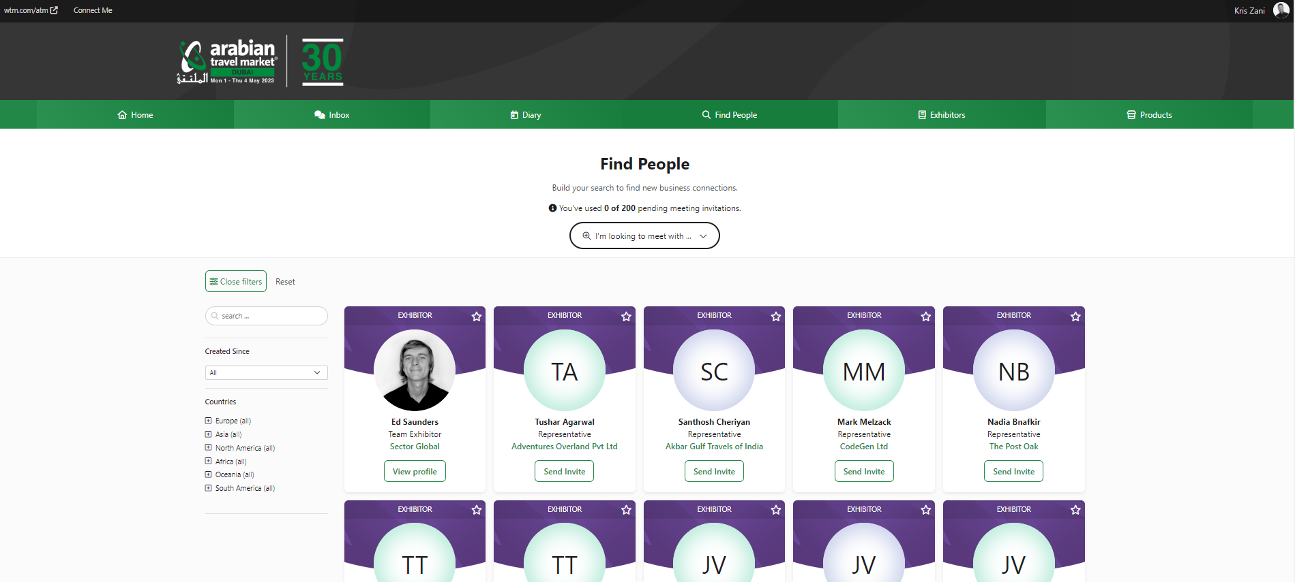
Find Exhibitor Delegates
Click on the ‘Find People’ tab on your Dashboard to start your Exhibitor search
Click on an Exhibitor profile card to view more information about the Exhibitor delegate and the company
Customise your search results and refine your search via products, country, title to find the right Exhibitor contact that matches your business needs
The Exhibitor Directory on your Dashboard is another great way to look for specific suppliers and find new ones
Click on the Send Invite button to request a meeting. Include a clear message as to your objective for wanting to meet.

Slide 11
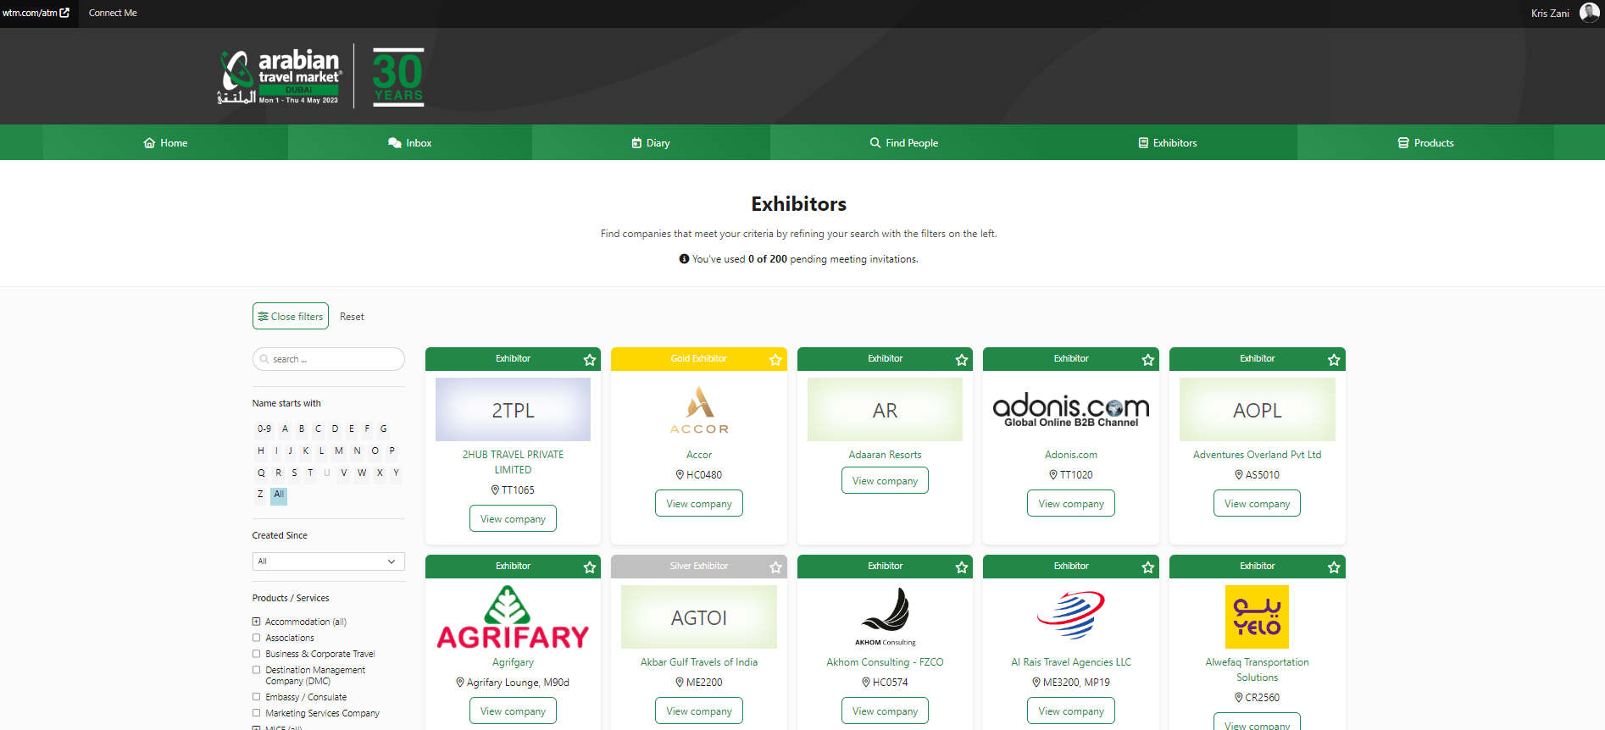
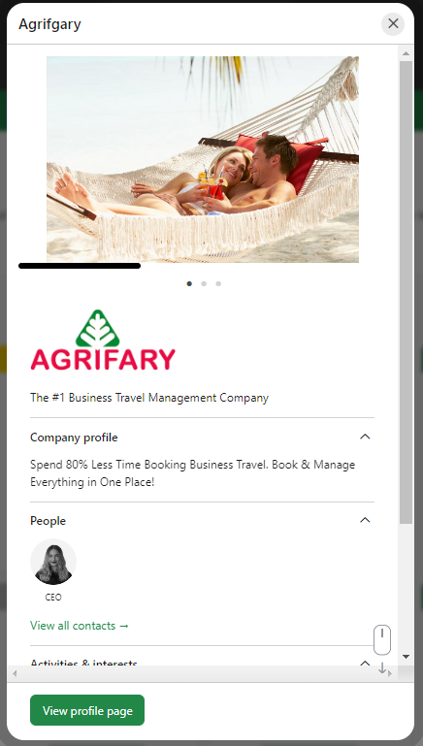
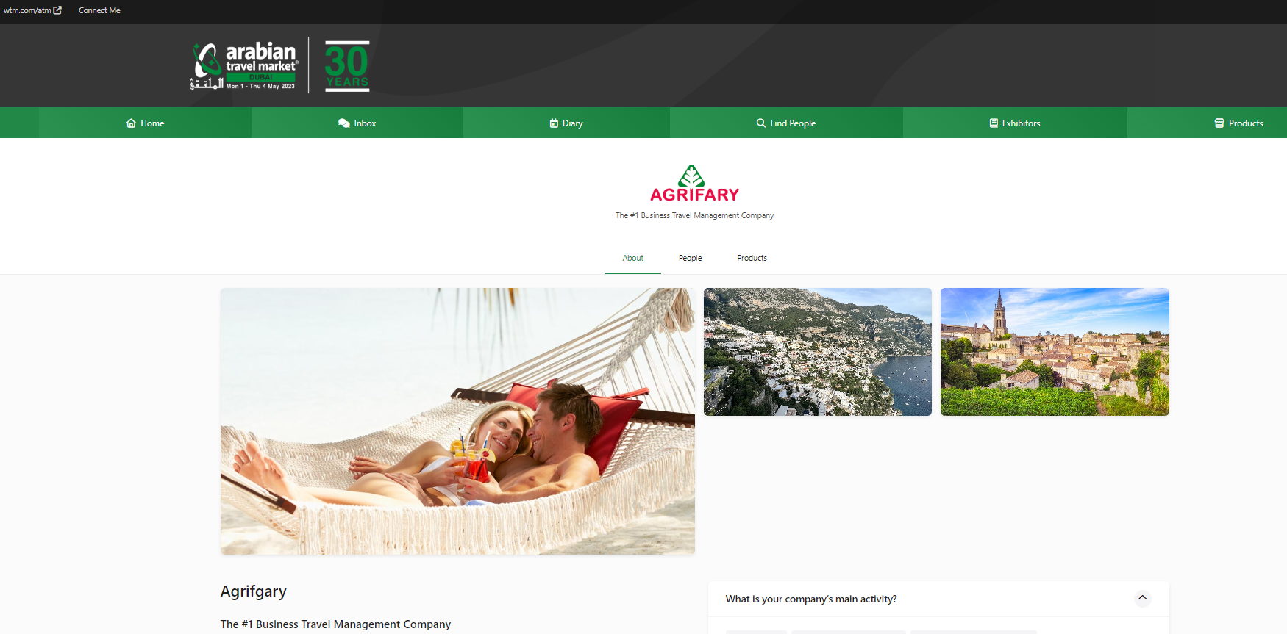
Exhibitor Directory
Click on the company name listed on the Exhibitor company profile card to
      View company information
      View which company employees are available to make meetings with
Use the ‘View Company’ tab on the profile card for a small preview of the company
From there you can click on the ‘View Profile’ tab for more information

Slide 12
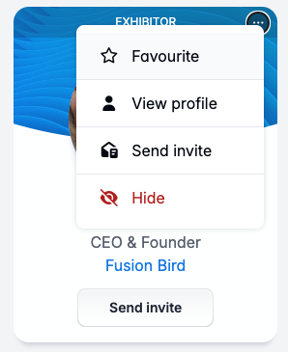
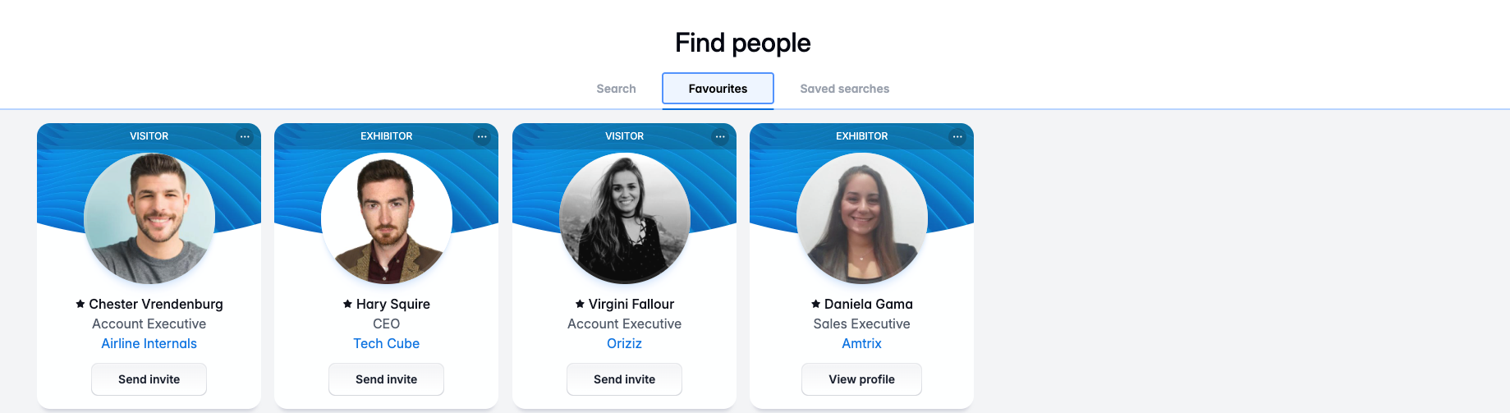
My ‘Favourites’ Tool
Click on the three dots in the right-hand corner of a profile card followed by Favourite to add an individual Exhibitor or Exhibiting Company to your favourites list.
To access ‘My Favourites’, click on the Favourites tab in each directory.
We advise not leaving it too long to contact the leads in your ‘favourites’ tab to avoid disappointment as diaries can fill up fast.
Add to favourites when browsing people and companies and return to this folder later to send invites. This makes the process quick and easy. And don’t worry, you won’t be able to send invites to people you have already invited for a meeting.

Slide 13
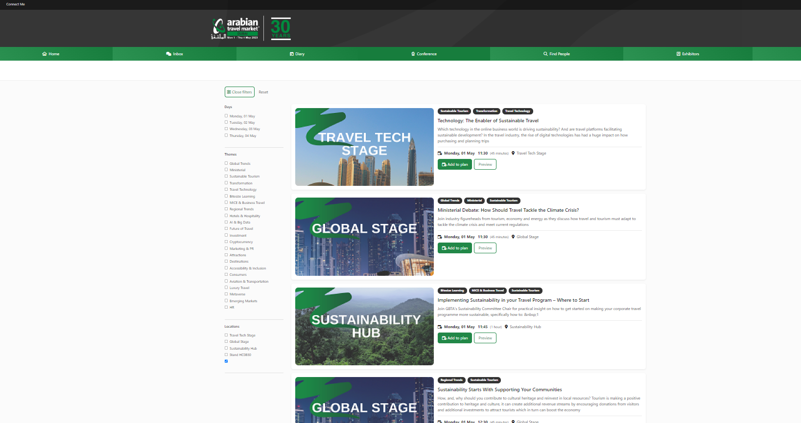
Conference Programme
The ATM conference programme will showcase the latest market trends and address current topics in a range of areas relevant to the travel industry
Click on the Conference Tab and use the filters to find the content most relevant to your business needs and interests
Once you select the conference you wish to attend, click on the ‘add to plan’ button to add it to your meeting diary

Slide 14
Your Profile

Slide 15
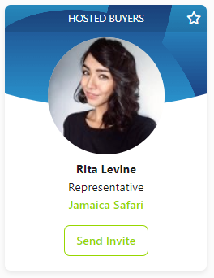
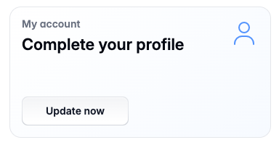
Profile Overview
Your profile MUST be 100% complete!
Complete all the Personal and Company Profile task cards on your home page in order to fulfil this
Exhibitors will be able to click on your profile card to see a summary of your product interests and company information. They will use this information to decide who they want to accept a meeting from and who request a meeting with
The information provided in your profile will also be used for your matchmaking recommendations and those shown to the Exhibitors
Your profile will directly affect your recommendations and visibility in the platform

Slide 16
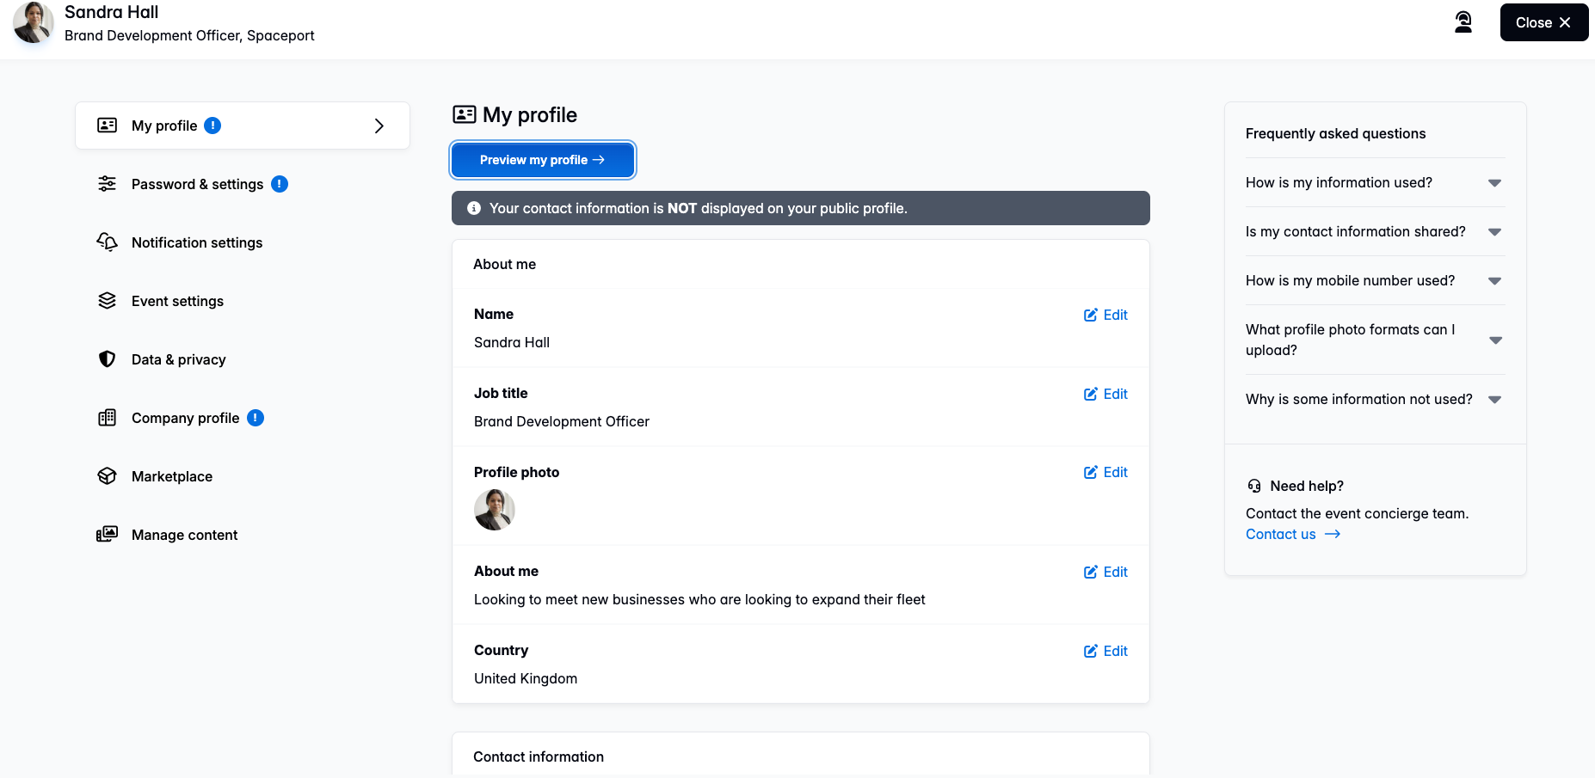
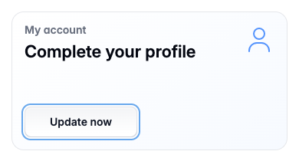
Completing Your Personal Profile
Click on the home page task card labelled ‘Complete your Profile’ and then select the personal profile tab
Be sure to update all areas of your profile to include a recent photo. You will have an option for a company logo in the Company profile
Double check the products and geographical regions you have selected. It pays to be specific so please don’t tick all!
We suggest keeping your profile in English to ensure that your profile is accessible to all suppliers
If you do include information in another language, we highly recommend including a translation in English

Slide 17
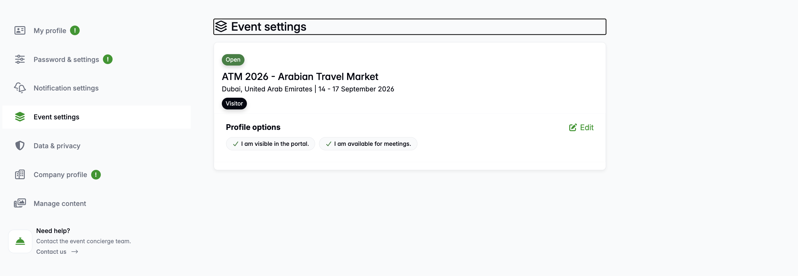
Your Event Settings
Ensure that as a Hosted Buyer, your event preferences are in GREEN. It is a requirement of the programme to be visible in the platform. Any found to the turned off, will be reactivated for you
Your communication preferences should also be GREEN

Slide 18
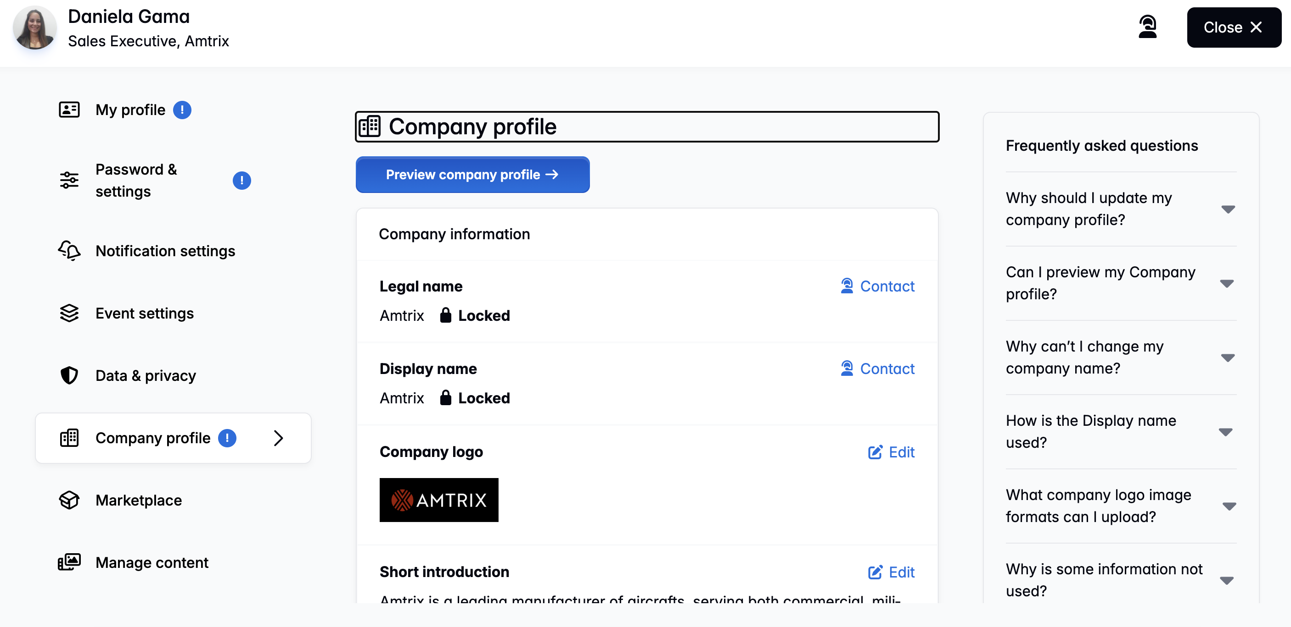
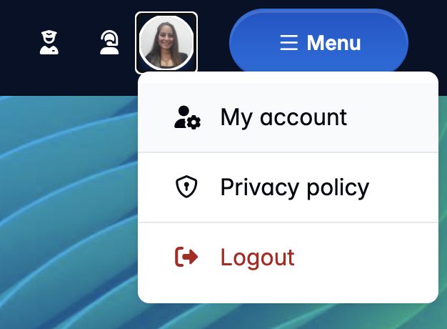
Completing Your Company Profile
Access your ‘Company Profile’ from the homepage task card
Click on the ‘Company Info’ and content tabs and complete all the informational sections
Don’t forget to add a company logo
Check the ‘product’ section to make sure this is all correct

Slide 19
Prescheduled Meetings

Slide 20
Meetings Explained
All meetings are scheduled to last for 20 minutes allowing 10 min walk between appointments.
Keep in mind that your next appointment may be at the opposite end of the show so it pays to plan ahead.
When a meeting request is made, the contact will receive an email with your meeting invitation. As soon as they accept, you will be notified by email
The recipient of the meeting request is the person who will set the time and date of the meeting
Meeting requests will only show times that mutually available to you both. It is therefore important to ensure you have blocked out time in your diary when you will be unavailable
You will receive email reminders should you have any outstanding meeting invites that require your attention
You will receive daily email and SMS or Whatsapp reminders for your meetings during the show but it is recommended to check your schedule in advance
Please check your online buyer inbox regularly for new meeting requests
As a Hosted Buyer you have the benefit of an unlimited number meeting requests or ‘meeting credits’

Slide 21
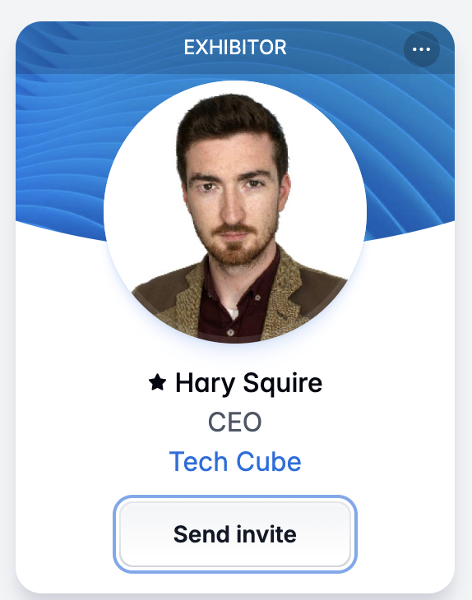
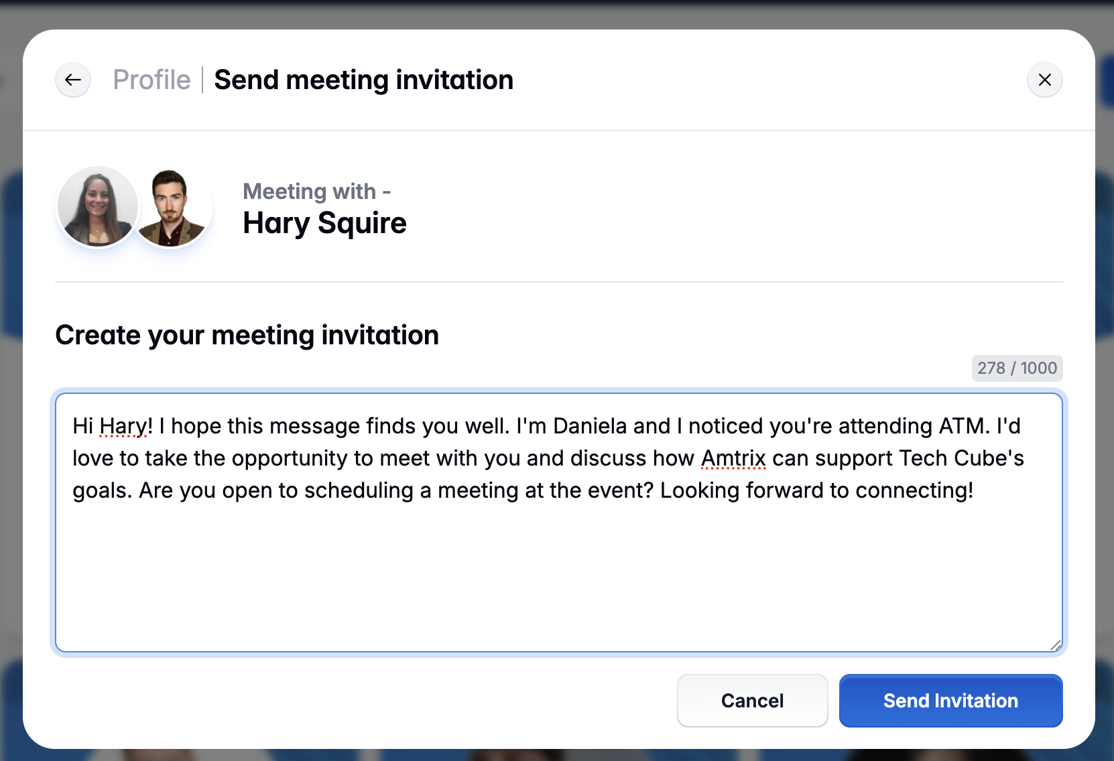
Sending Meeting Requests
When sending a meeting request it is important to be specific with your message
Be clear with the Exhibitor as to why you would like to meet them
It is always best to keep the message short but to the point
Remember that it is the person accepting the meeting request who will set the time and date of the meeting. They will only be able to choose from dates and times that are available to you both

Slide 22
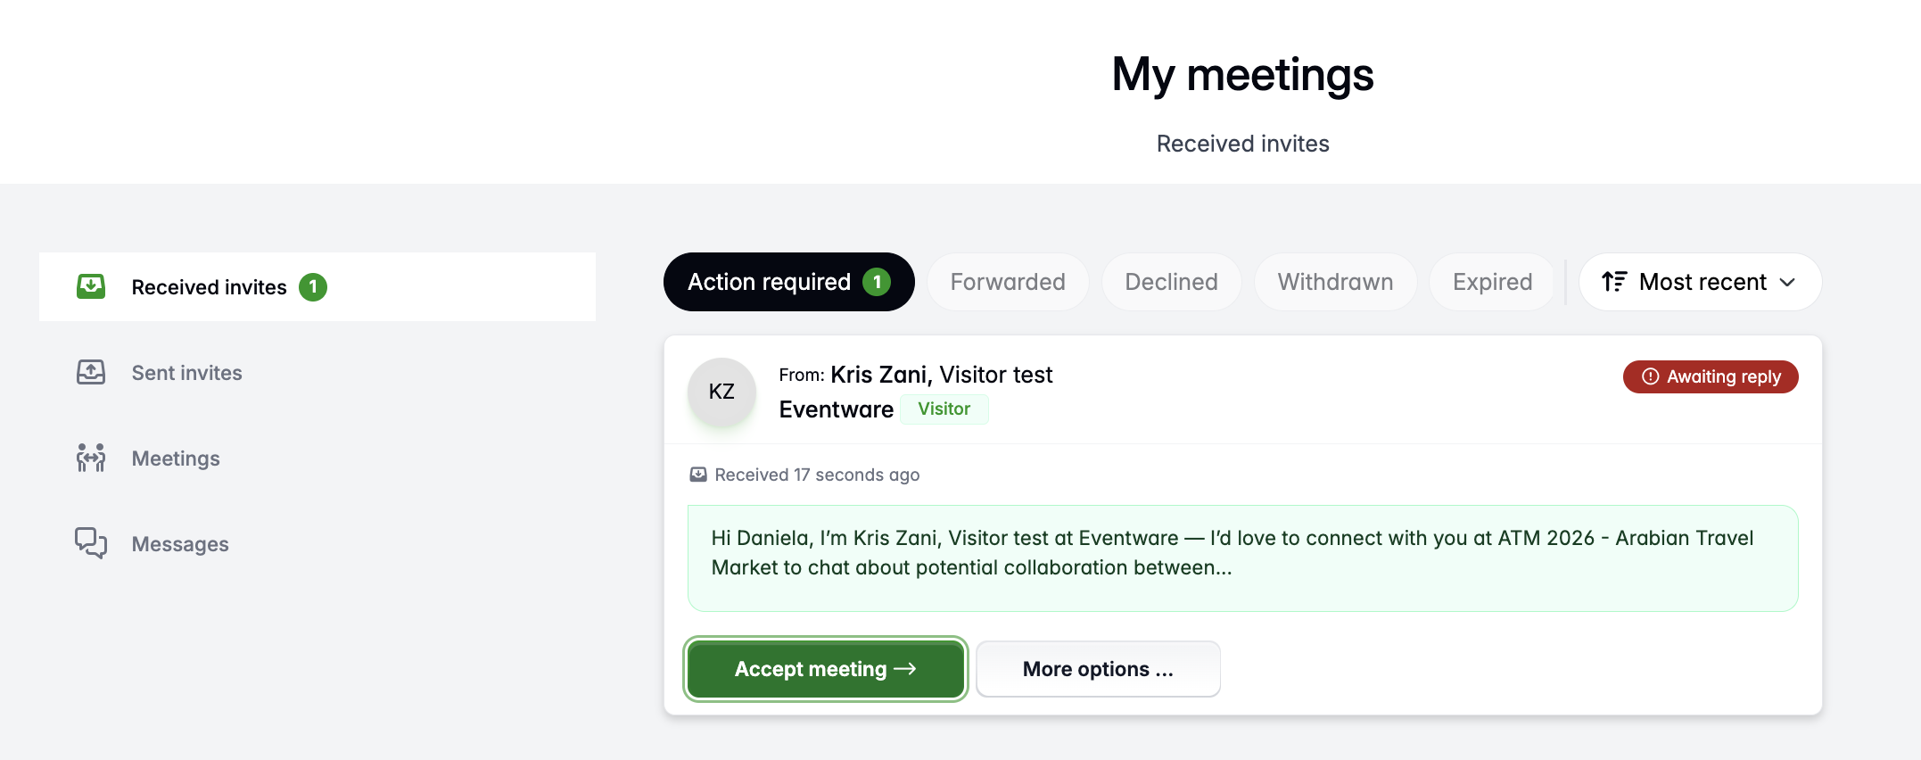
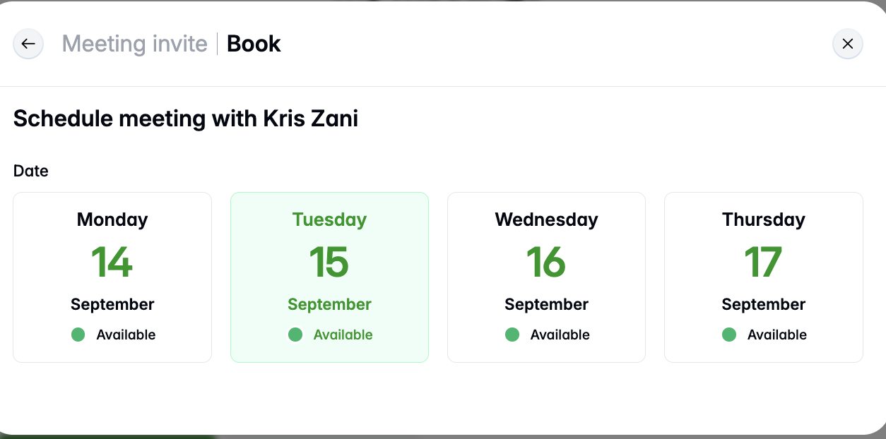
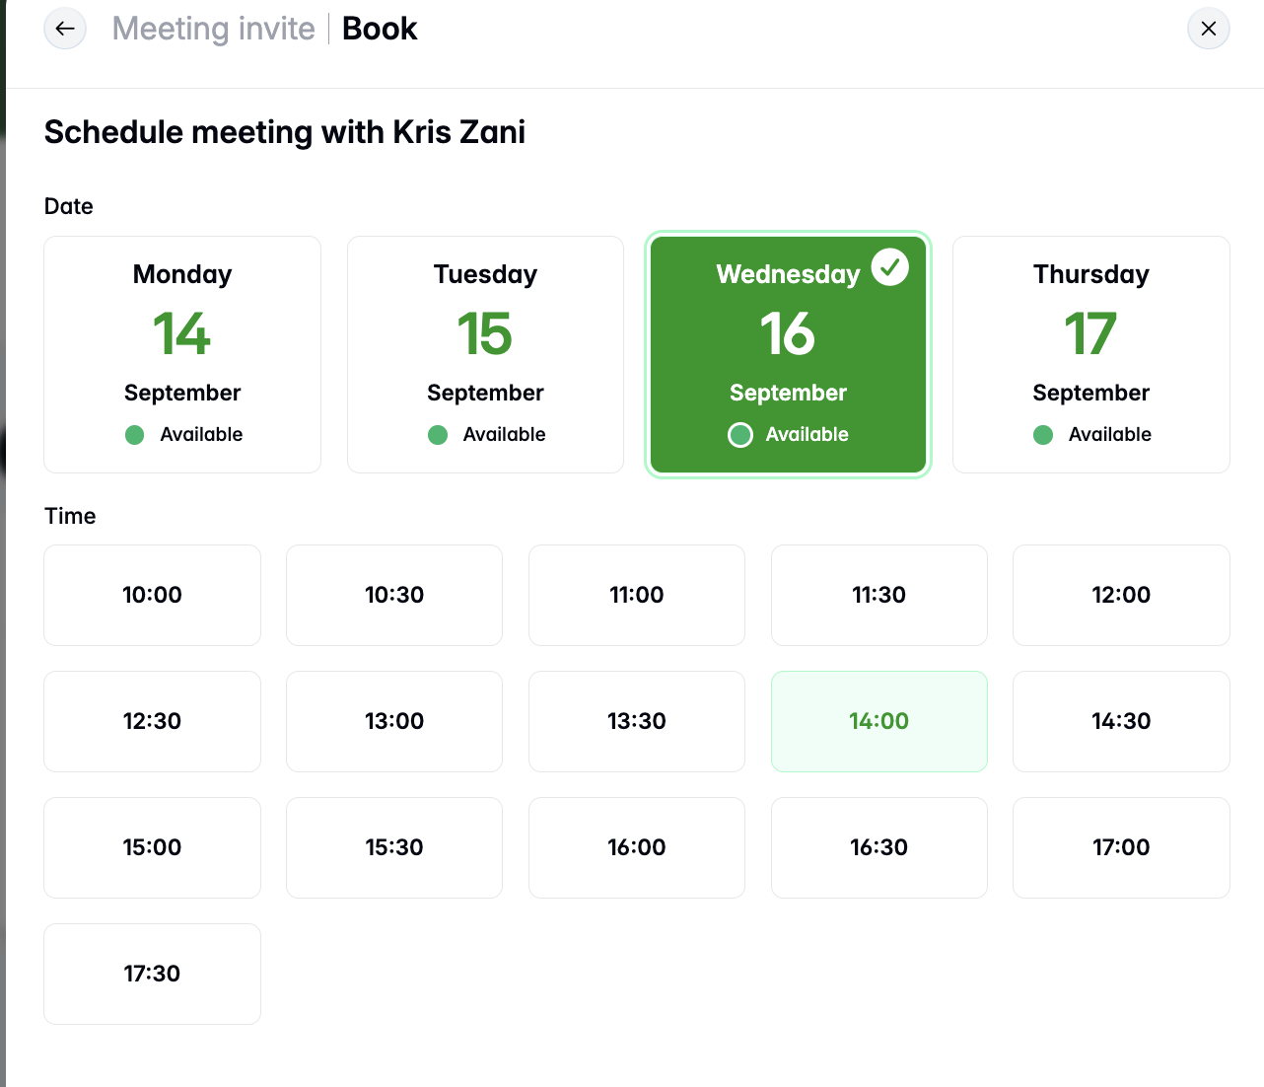
Accepting Meetings
If you wish to accept the meeting, select the date and time that suits you best. You will only be shown times that are available to you both
Once you accept a meeting it will show in your online meetings calendar and in your confirmed meetings inbox
If you decide to decline the meeting, it is always a courtesy to add a message for the Exhibitor

Slide 23
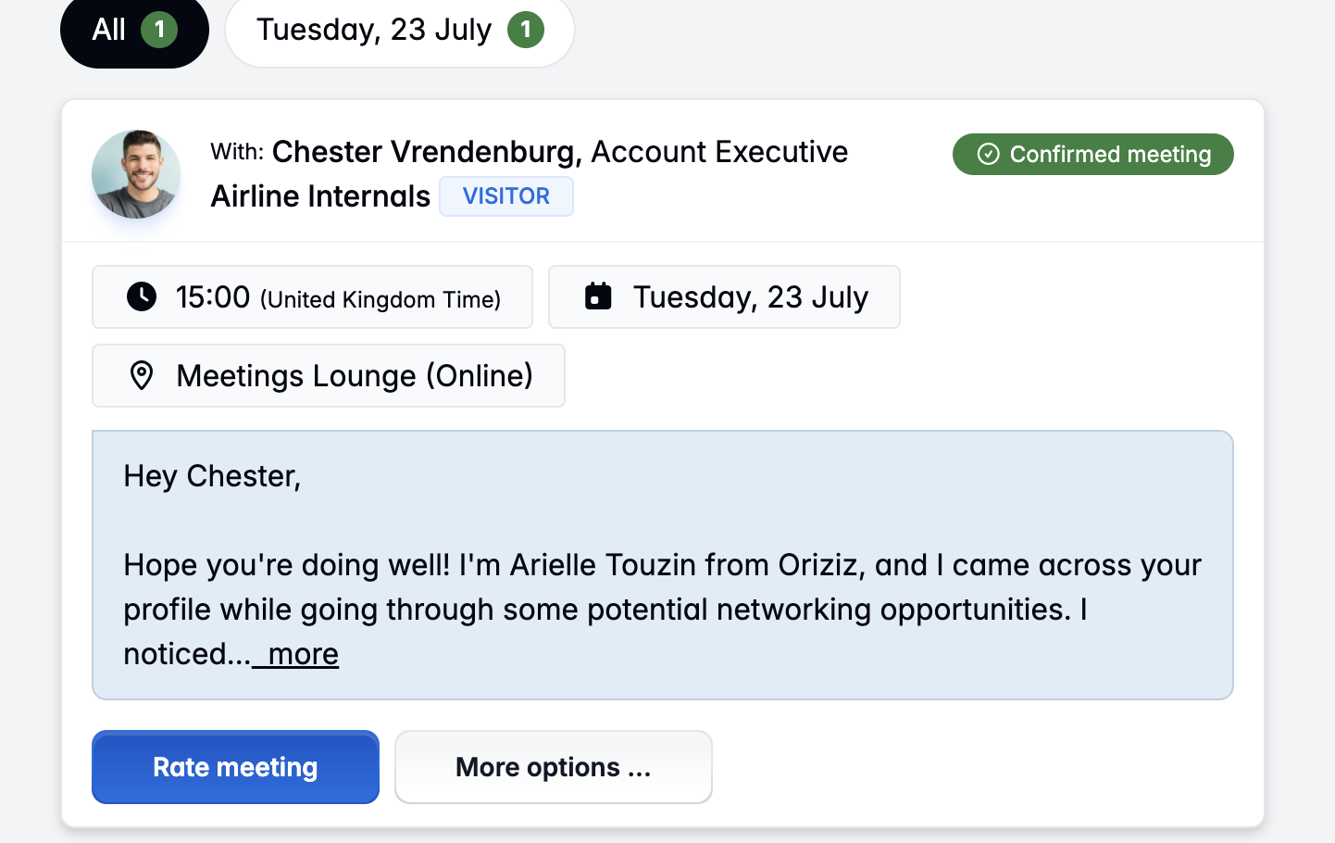
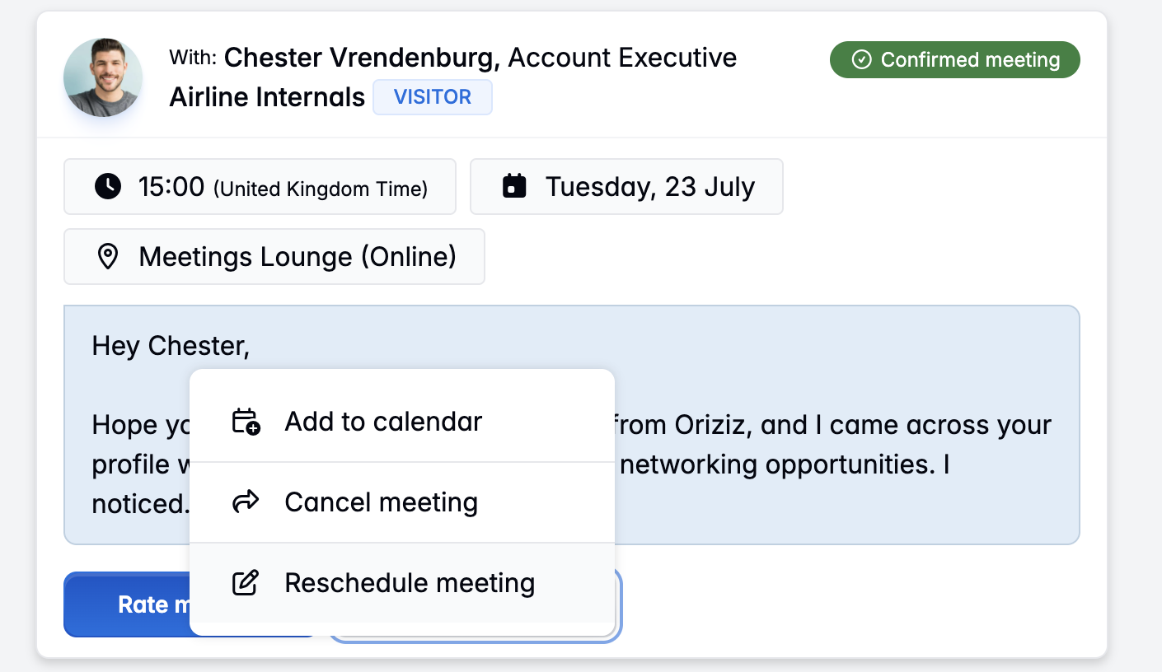
Rescheduling a Meeting
Click on your Inbox on the dashboard
Select the Confirmed Meetings tab and click on the details button of the meeting you would like to reschedule
Click on Reschedule Meeting and follow the prompts to choose a new date and time. Note that you will only be able to reschedule if you have a mutual date and time available
If you need to cancel the meeting; select the reason and out of courtesy include a message to the Exhibitor to explain the cancellation. Then, click on the company name to take you to their company profile page where you can drop your business card instead

Slide 24

Meeting Top Tips
Please kindly execute meeting etiquette and actively respond to meeting invites from Exhibitors in a timely manner
If you are unable to attend or do not wish to accept the meeting, please do let the Exhibitor know
Check your meeting requests and My Meetings inbox regularly so you don’t miss a meeting invite
Should you need to cancel a meeting, please do so with as much notice as possible for the Exhibitor and extend the courtesy of an explanation for the cancellation
Unanswered Exhibitor meeting requests will be automatically expire every so often so don’t miss out!
Allow yourself enough time to get from one meeting to another. You don’t want to be listed as a ‘No Show’
If you need to re-schedule a meeting, please do so with plenty of time so the Exhibitor can accommodate the new arrangement

Slide 25
Meeting Ratings
It is a requirement of the Hosted Buyer programme to rate your meetings.
A ‘Rate Meetings’ tab will appear on the homepage at the start of the show
Please rate the meeting accurately and honestly
Your ratings and comments will not be shared or displayed publically and will not be seen by your meeting partner
Things to consider when rating the meeting: Did the Exhibitor show up? / Did the meeting go well? Let us know! Your feedback counts!
Your appointment ratings and feedback helps us improve the Hosted Buyer Programme and meetings platform year on year
Use the meeting ratings to rate your meetings only! You will be sent a post-show survey for you to complete if you have any comments, feedback, suggestions and/or recommendations that you would like to make about ATM 2026 after the close of the show
Once you complete your rating and comment, they will disappear from view. You will not be able to make any amends after you submit them

Slide 26
Generating Leads

Slide 27
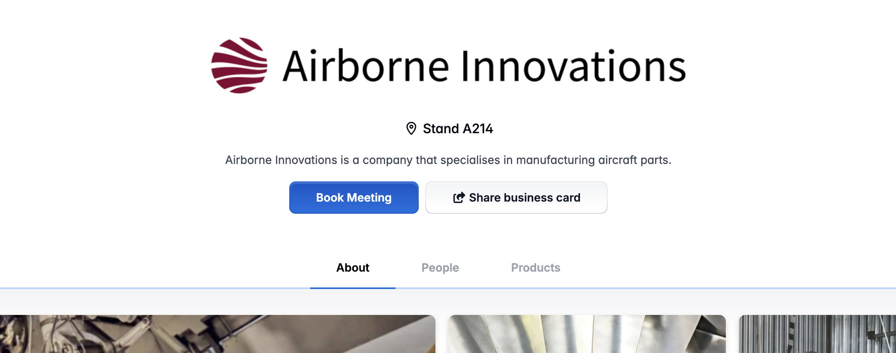
Share Business Card Feature
If you are unable to meet a supplier, you can always share your business card with them
  View the ‘company profile’ of the Exhibitor you would like to leave your contact details with
  Click on the ‘Share Business Card’ button
  Maximise your use of the platform and use this as a great way to get in front of even more Exhibitors, especially those you are unable to arrange a meeting with

Slide 28
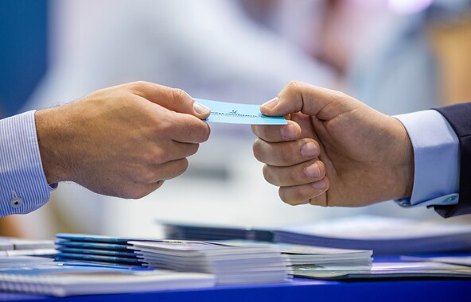
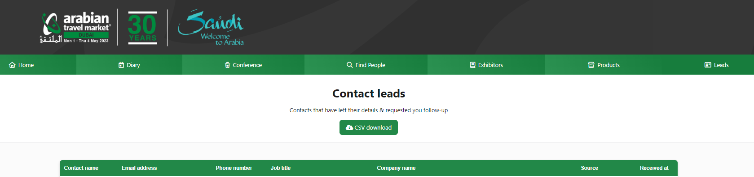
Downloading Business Leads
Your Final Diary
  Download your Diary at the end of show to view a summary of your pre-scheduled meetings and email contacts
  Your diary will become available to download about a week before the show opens
From Your Business Card Leads
  Download business card leads from your ‘Leads’ section on the Dashboard. This is where Exhibitors will drop their business cards with you
  Your business card ‘Leads’ section will only be available once the show opens and will remain open for about a week post show

Slide 29
Top Tips and Technical Support

Slide 30

Meetings Platform Top Tips
Complete your profile and company profile the homepage
Make sure you check your appointment diary and platform inbox regularly!
Pre-schedule as many meetings before the event starts so you don’t miss out on potential business opportunities
Ensure you have met the Hosted Buyer minimum appointment requirement of 10 pre-scheduled meetings per day. Meetings scheduled outside the platform will not be counted!
Our Exhibitor list will continuously grow as we move towards the show. Check back in regularly for new suppliers
Attend ALL of your pre-scheduled meetings so that Exhibitors do not rate you as a ‘no show’ which could incur a charge, affect your overall rating as a Hosted Buyer and future applications
Rate your meetings as soon as possible after they have finished
Check your Exhibitor recommendations on the homepage
Make good use of the My Favourites and Share Business Card tools. Ask the Exhibitor to also drop their card with you
Download your schedule and business leads post show

Slide 31

Technical Support
For URGENT onsite issues regarding schedules, meetings please visit the ATM Meets support desk on the show floor
For URGENT issues before the show regarding schedules, meetings or the ATM Meets platform please contact the ATM Meets support team directly at atm@app.eventware.com Please also copy in the Hosted Buyer Team.
For a non-urgent meeting reschedule, please try to contact your meeting partner directly to arrange the meeting for another time
The Hosted Buyer team will have limited access to emails during ATM but will respond to emails as soon as possible. Where possible, speak to the team onsite.
We advise using Chrome or Edge when accessing the platform and pre-scheduling your meetings
To contact the ATM Hosted Buyer team, please email atm-buyers@rxglobal.com

Slide 32


ATM Hosted Buyer Team
ATM-buyers@rxglobal.com
Destination
Partner:
Official
Partners:

