Slide 2
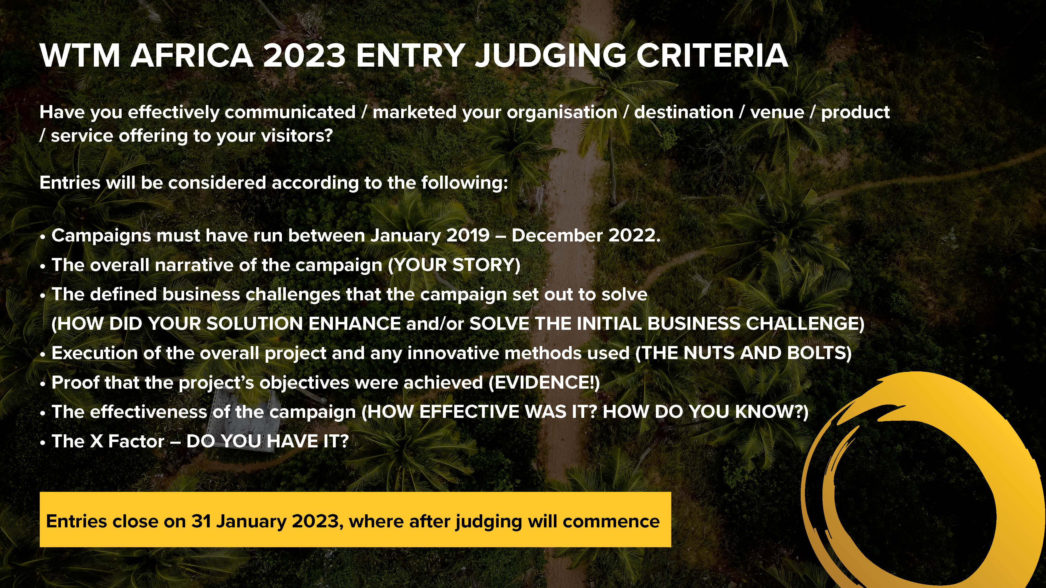

Slide 3
Enter Category Name here:
Most Compelling ……………………………………………………….. Story

Slide 4
Who are you nominating?
Company:
Address:
City/Town:
Country:
Email Address:
Phone Number:
Website:
SM Handle/s:

Slide 5
Here, answer the WHY question. What did your destination / organisation do that makes you eligible to win this award. Get real and tell us your story! (500 max) (Compulsory)
Enter text here ………………….
* Insert additional slides as needed

Slide 6
Does this nomination refer to a specific campaign, project or product? Give us an overview of what the project / product is about, who were your target audience, how did you reach them? How has your efforts or solutions enhanced your travel and tourism initiatives? This is the nuts and bolts stuff! (Compulsory)
Enter text here …………………
* Insert additional slides as needed

Slide 7
How did you measure the impact of your campaign, project or product offering? Show us evidence of audience engagement. Think statistics. This could be url links, SM handles, articles, reviews, etc (Compulsory)
Enter text here ………………….
* Insert additional slides as needed

Slide 8
Its reflection time! What worked, what didn’t work? What obstacles did you encounter and how did you resolve them? What lessons did you learn? (Compulsory)
Enter text here ………………….
* Insert additional slides as needed

Slide 9
Whether it’s a brochure, a video or something else you’d like us to see, attach this to your awards submission. There is no limit to the information you can send to help tell your story (but please make sure its relevant!)
* Insert additional slides as needed

Slide 10
Anything else you would like to add?
* Insert additional slides as needed

